Slide 1
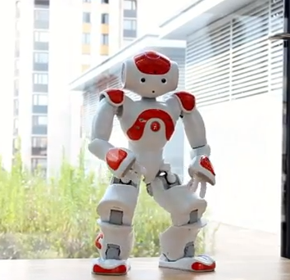
Ice skating with Naomi
Evolutionary Algorithms
Bas Bootsma
Roland Meertens
Tom de Ruijter
2 October 2012

Slide 2
Goal
“Learning Naomi to ice skate in a simulated environment using HyperNEAT.”
Ice skating:
Without ice skates;
In a straight line.
Stages in ice skating:
Initial stage (i.e. getting started);
Recurring stage (i.e. the actual ice skating movement).
Notes:
Why ice skating?
Not yet done.
‘How can robots move on uneven surfaces?’
Why evolutionary methods?
Little human programming
Proven to work for quadrupeds
Why Nao?
Because it’s available
No skates & straight lines: simplicity & easier balancing
First recurring stage: modular approach and difficult enough

Slide 3
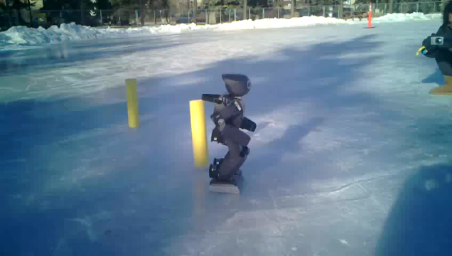
State of the art
Notes:
“Ice skating humanoid robot (2012)”

Slide 4
Implementation
Simulator with a physics engine;
Initial speed (since focus on recurring stage);
Neuro-evolution:
With HyperNEAT using indirect encoding.

Slide 5
Simulator
Gazebo:
Simulating the environment (match surface friction with that of ice);
Simulating the robot (i.e. a stick model of the robot).
Add neuro-evolution algorithm feedback
Should be easy to:
Run multiple trials;
Retrieve data from the simulator (i.e. position of the robot).
Notes:
Reality gap: probably high, because of simulator
Properties of ice – low surface friction & flat.
How does neuro-evolution work?
Why Gazebo
Previous experience
Most used open-source simulators

Slide 6
HyperNEAT
NEAT:
Increase complexity over time (keep track of genes);
Speciating the population (compete in niches at first);
Initially uniform population.
HyperNEAT (extension of NEAT):
Learn regularities (i.e. similarity or repeating patterns);
Input and output placement.

Slide 7
HyperNEAT
Mapping:
Initially only leg joints jaw and pitch (possibly extending with other joints, i.e. arms);
Discrete time steps for feedback (e.g. 100 ms).
Fitness:
Maximalization within N seconds;
Falling over means minimal fitness;
Properties:
Distance;
Speed.

Slide 8
Previous work
Ice Skating Humanoid Robot
Chris Iverach-Brereton, Andrew Winton and Jacky Baltes (2012)
Evolving Robot Gaits in Hardware: the HyperNEAT Generative Encoding Vs. Parameter Optimization
Jason Yosinski, Jeff Clune, Diana Hidalgo, Sarah Nguyen, Juan Cristobal Zagal, and Hod Lipson (2011)
A Step Toward Evolving Biped Walking Behavior Through Indirect Encoding
Randal Olsen (2010)
Gait Evolution for Humanoid Robot in a Physically Simulated Environment
Nesrine Ouannes, NourEddine Djedi, Yves Duthen and Hervé Luga (2011)

Slide 9
Discussion
What types of input could we use to initialize the algorithm?
Usage of Kinect to capture stick models
Working walking gait (on ice)
…
Ideas on fitness
Other simulators / algorithms

